Slide 1

Hierarchical Clustering
Huynh thanh dung

Slide 2
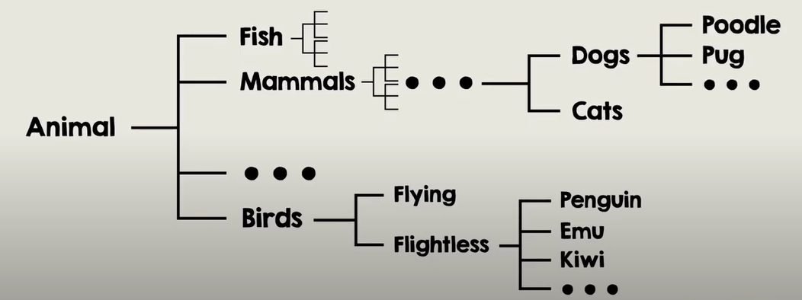
Hierarchical Clustering

Slide 3
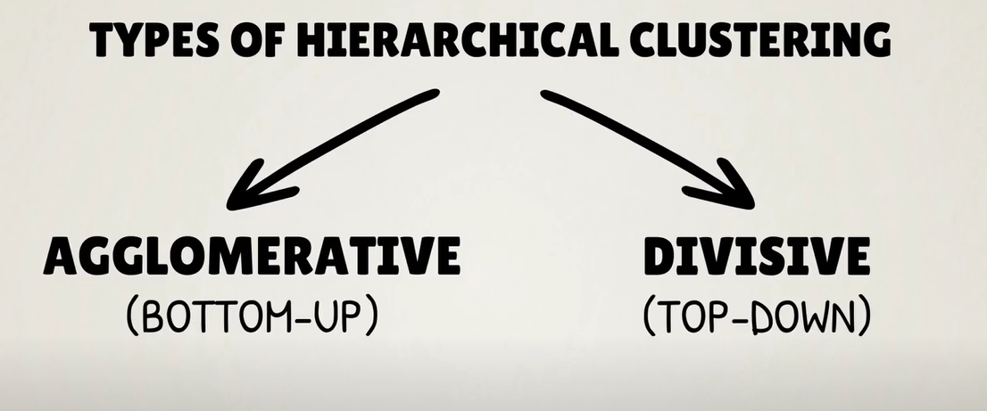
Types of Hierarchical Clustering
Notes:
There are two types of Hierarchical Clustering:
+ Agglomerative (or Bottom-up)
+ Divisive (or Top-down)

Slide 4
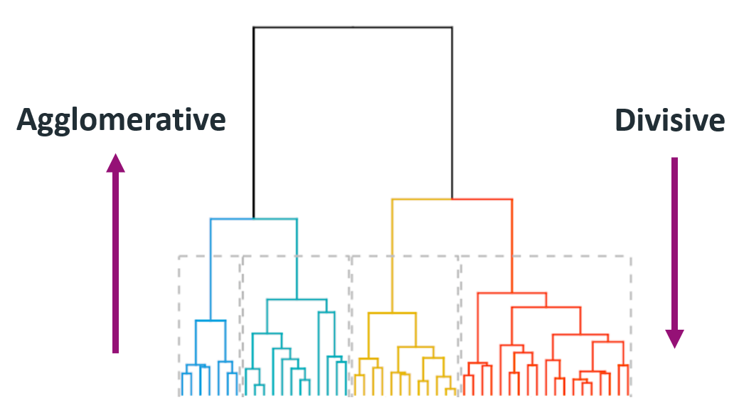
Types of Hierarchical Clustering
Notes:
Divisive Clustering In this technique, entire data or observation is assigned to a single cluster. The cluster is further split until there is one cluster for each data or observation.
Agglomerative Clustering is popularly known as a bottom-up approach, wherein each data or observation is treated as its cluster. A pair of clusters are combined until all clusters are merged into one big cluster that contains all the data.

Slide 5
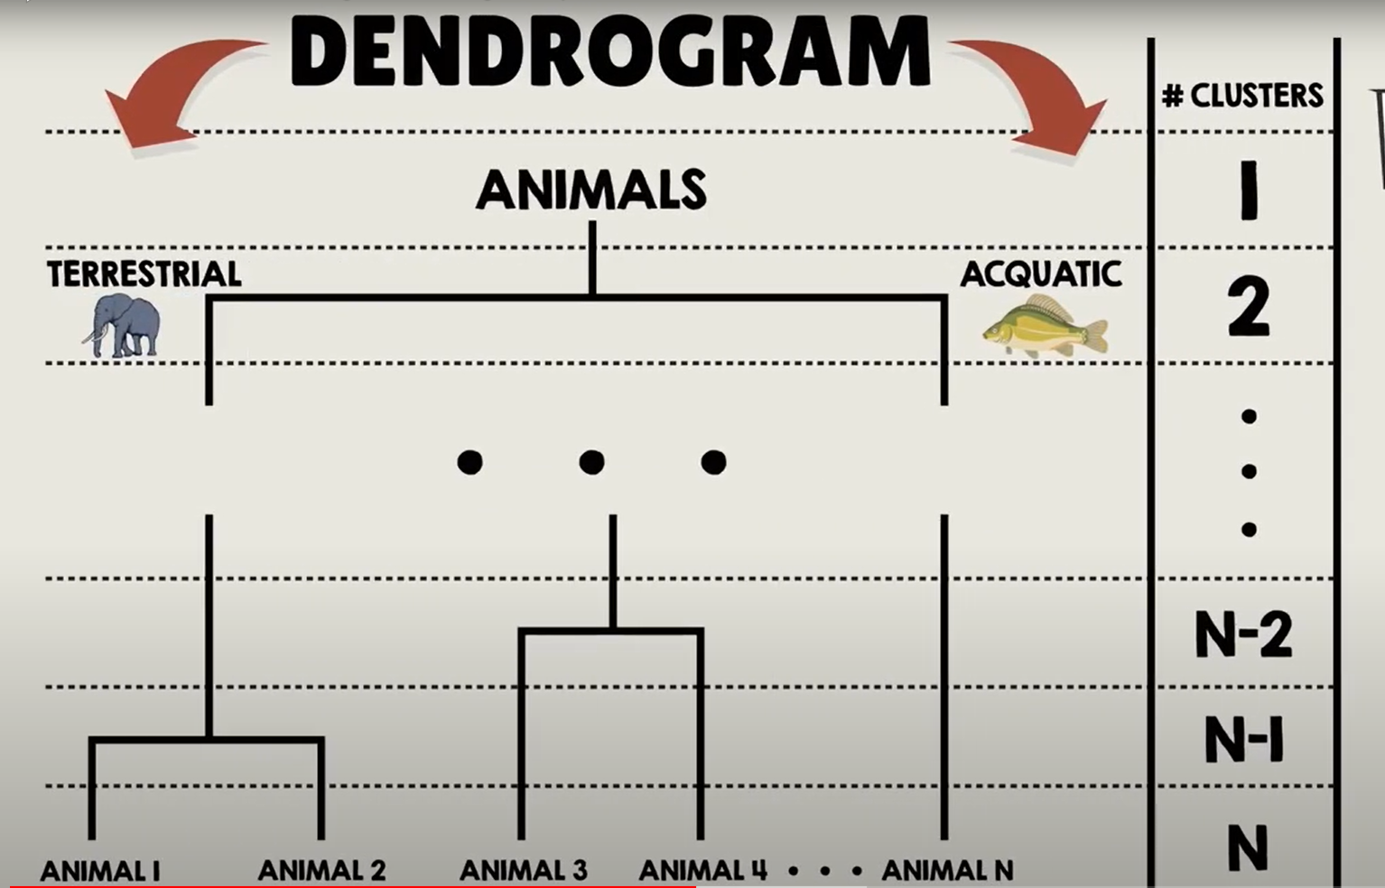
Agglomerative Clustering
Notes:
The name for this type of graph is Dendrogram
The two closest clusters are combined, then another two, and so on, until we are left with a single cluster.
Note: that all cluster solutions are nested inside this Dendrogram.

Slide 6
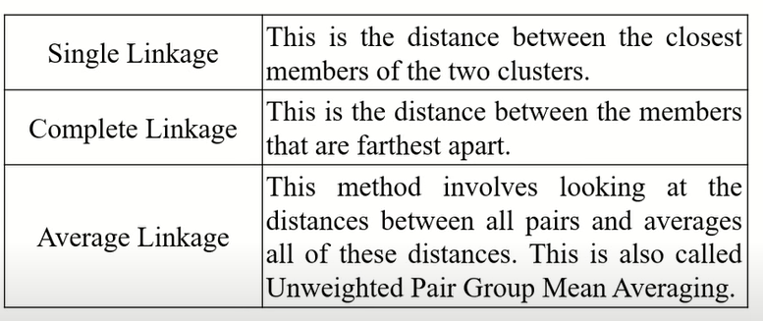
Linkage criteria

Slide 7
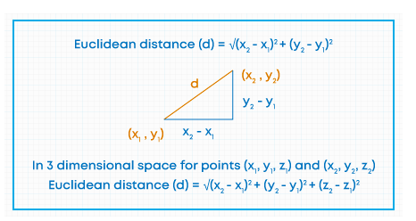
Distance

Slide 8
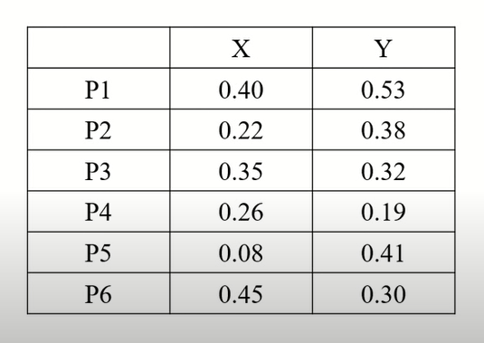
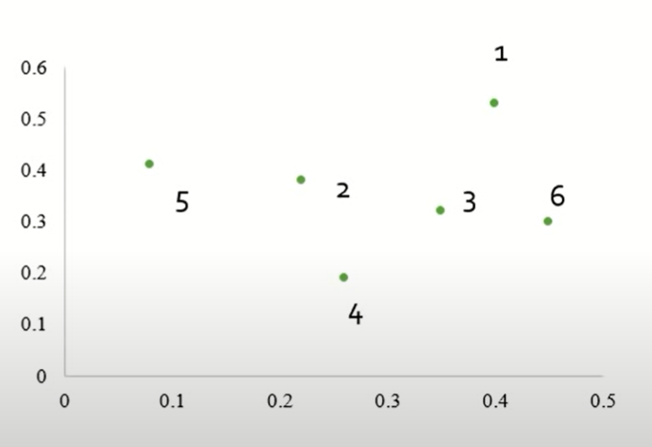
Example

Slide 9
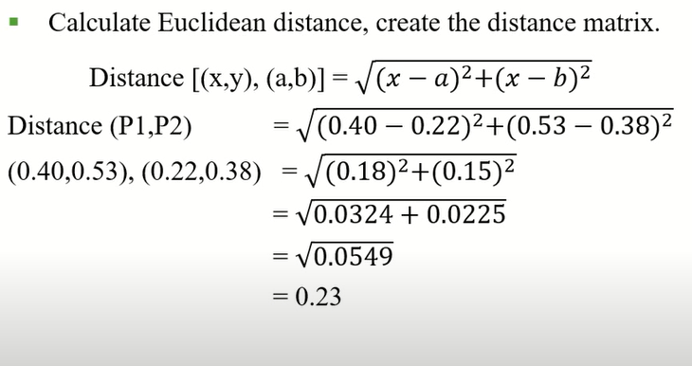
Example

Slide 10
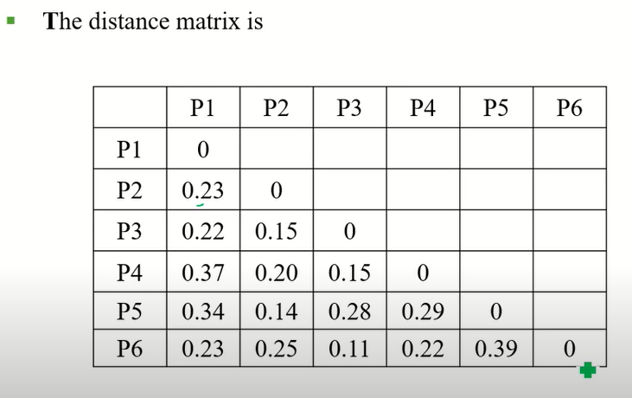
Example

Slide 11
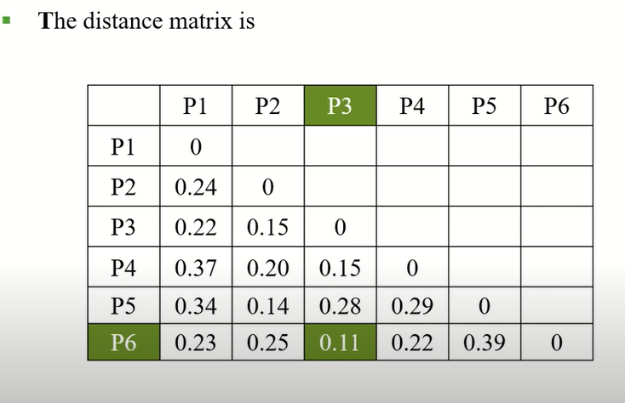
Example

Slide 12
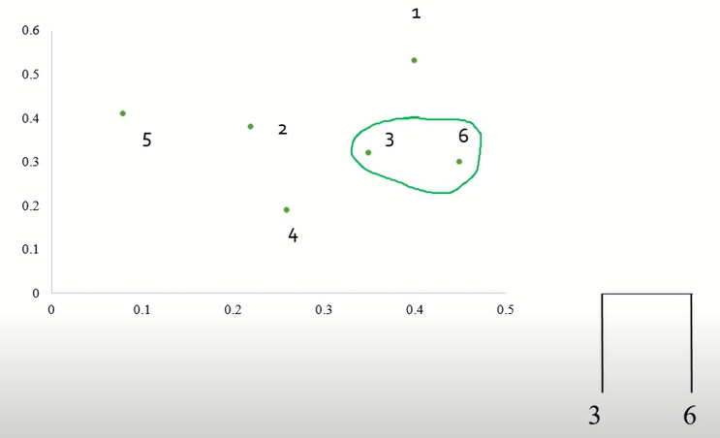
Example

Slide 13
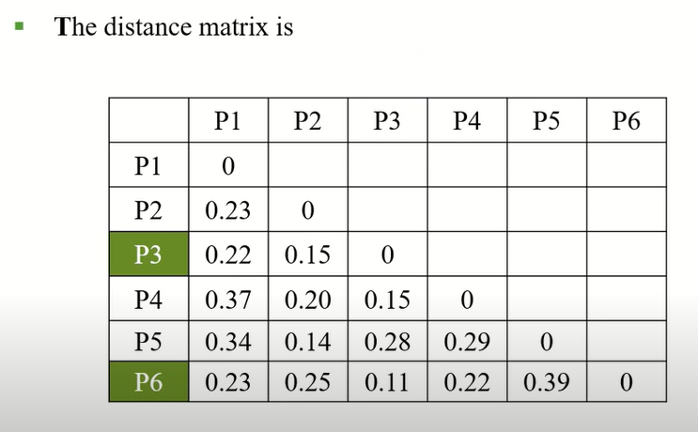
Example

Slide 14
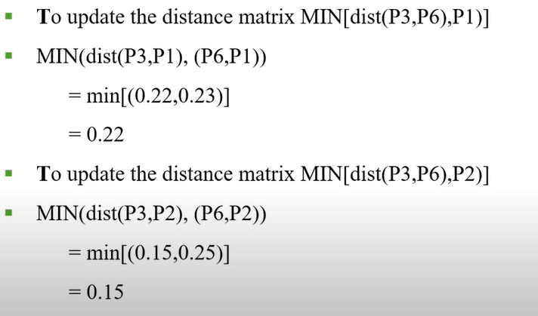
Example

Slide 15
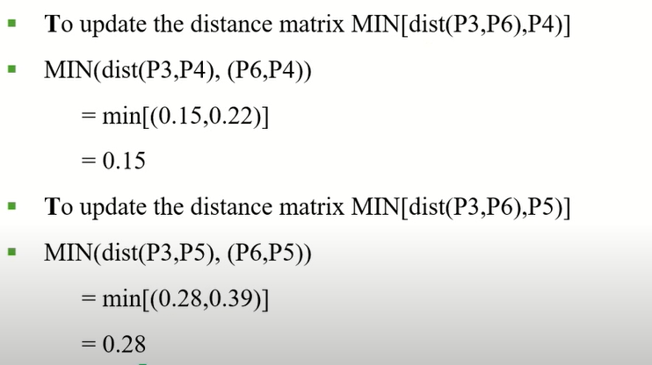
Example

Slide 16
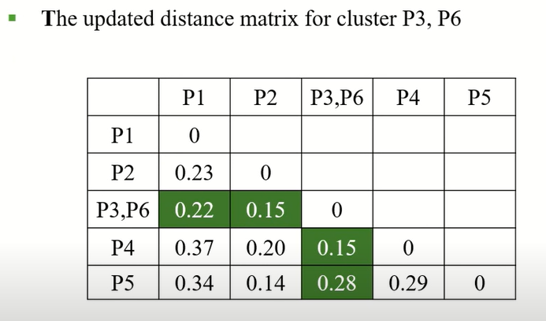
Example

Slide 17
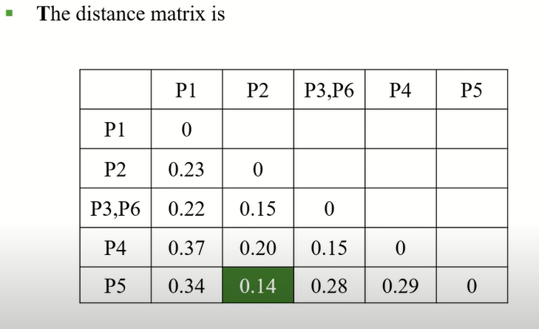
Example

Slide 18
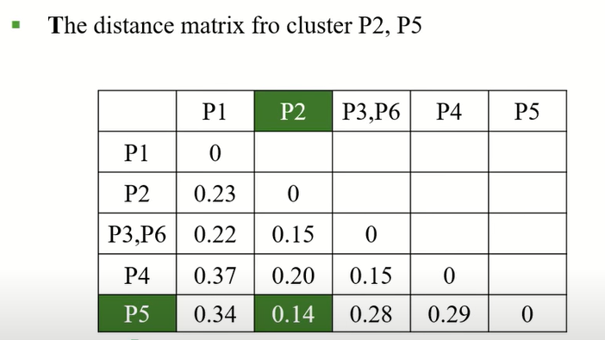
Example

Slide 19
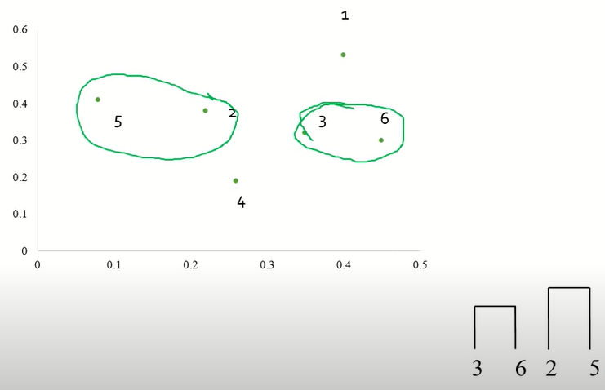
Example

Slide 20
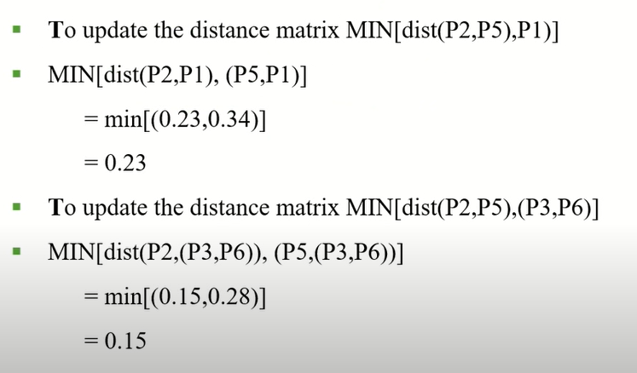
Example

Slide 21
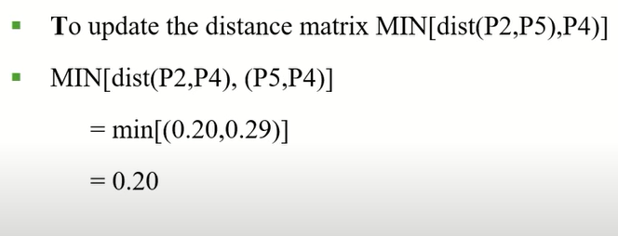
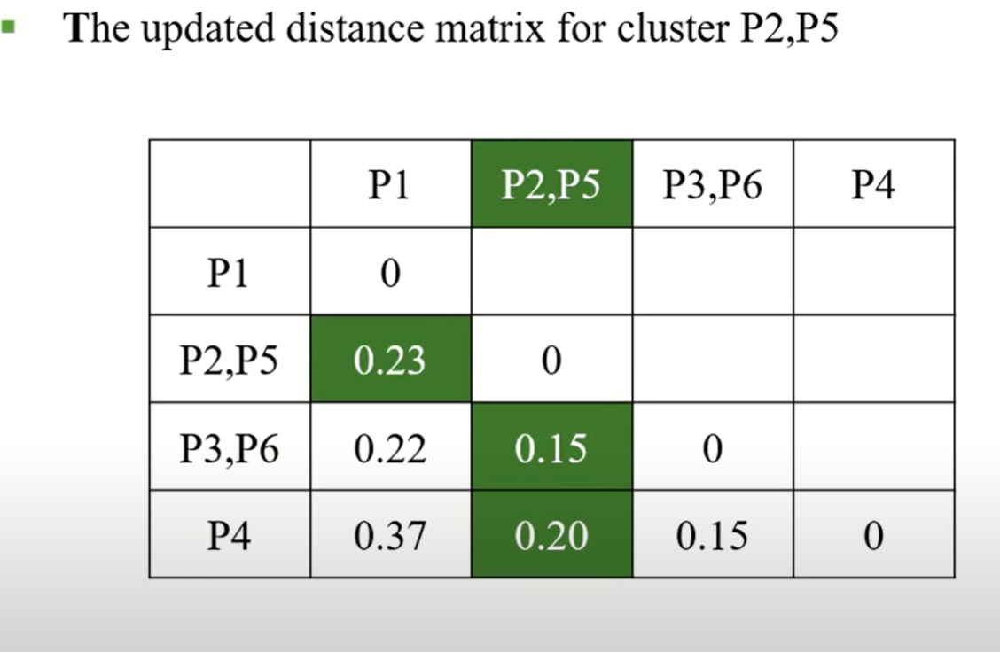
Example

Slide 22
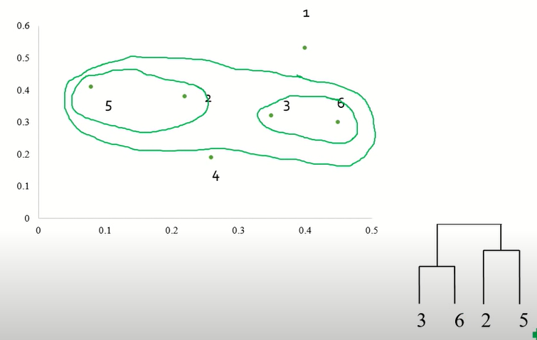
Example

Slide 23
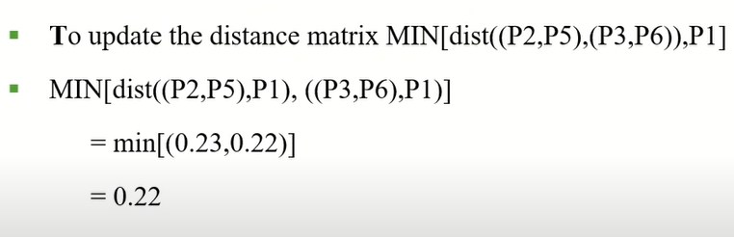
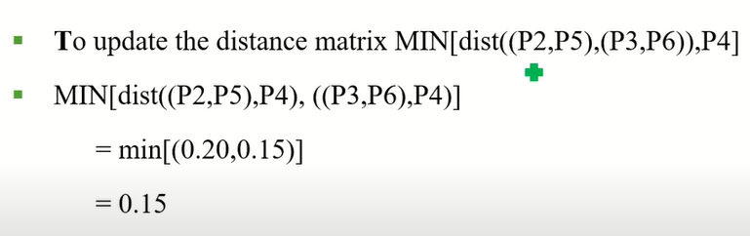
Example

Slide 24
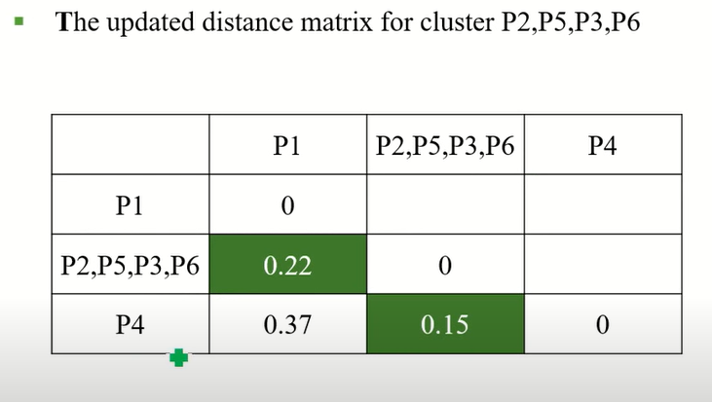
Example

Slide 25
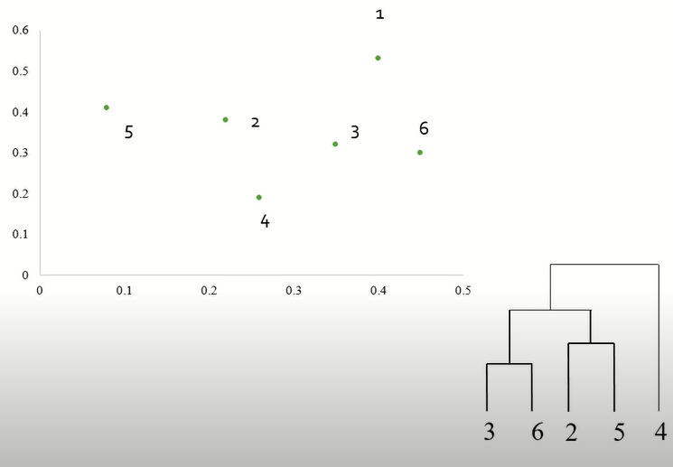
Example

Slide 26
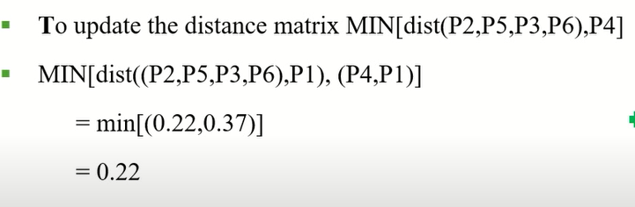
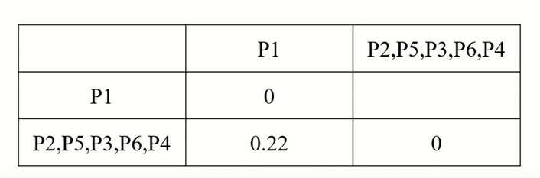
Example

Slide 27
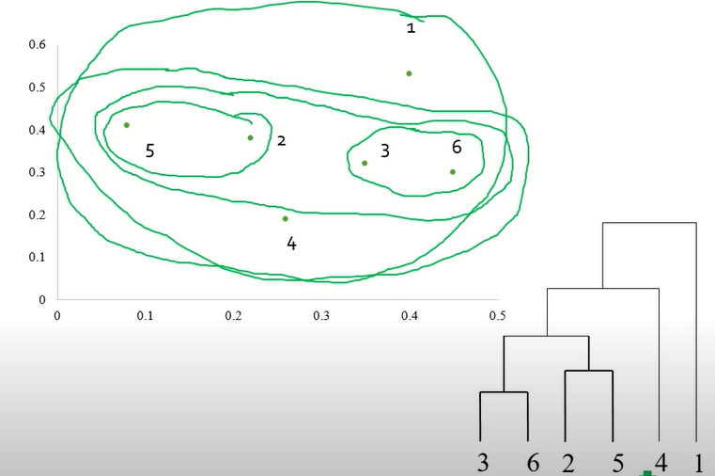
Example

Slide 28

Demo

Slide 29
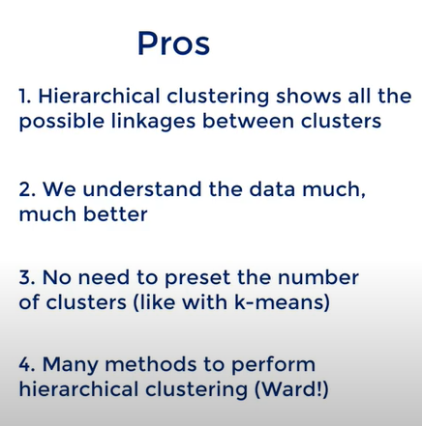
Demo

Slide 30
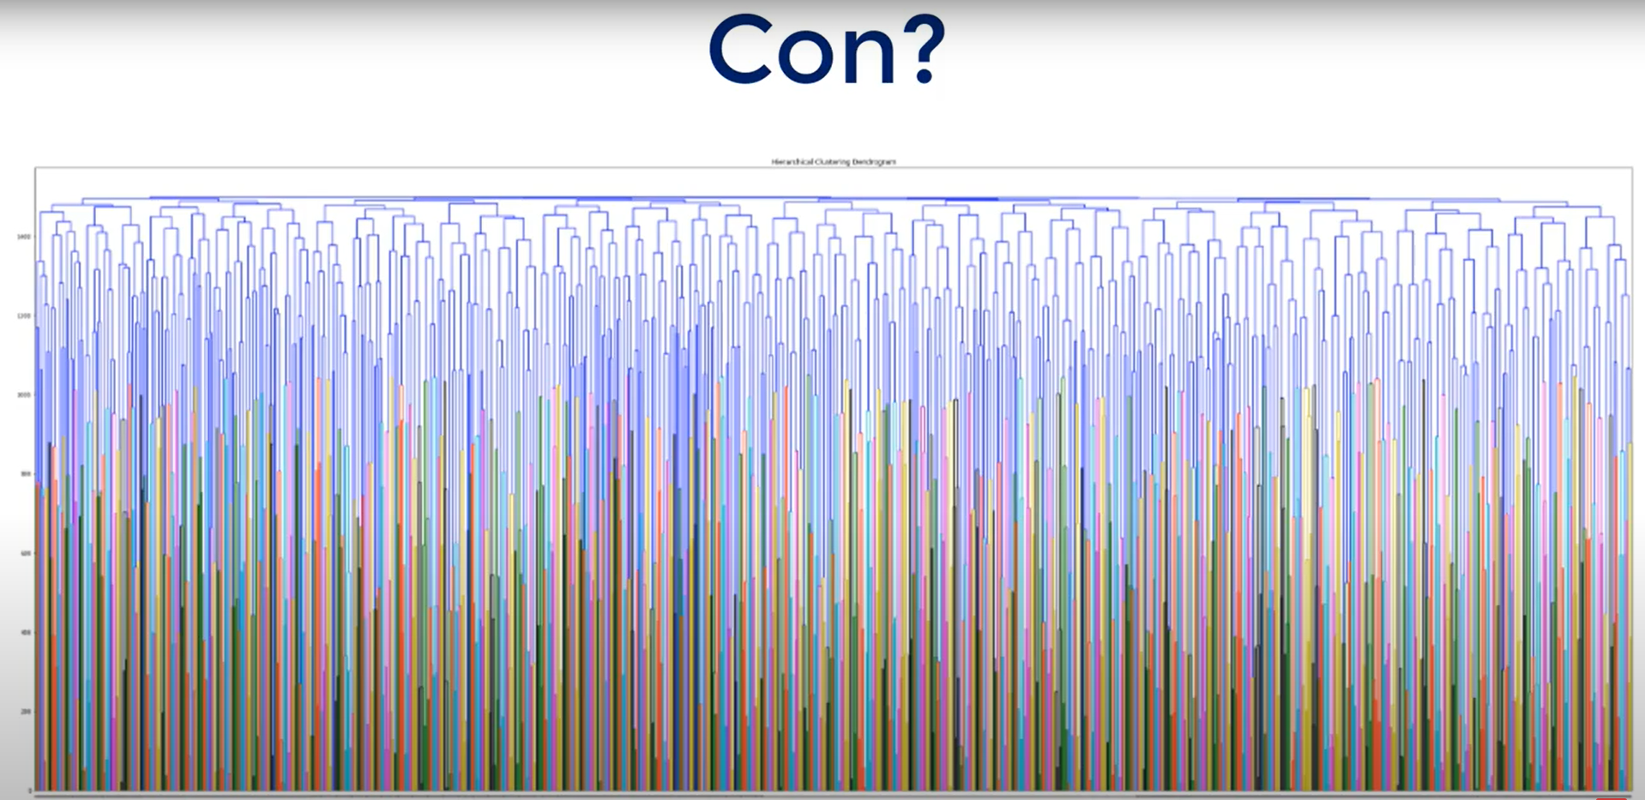
Demo
Notes:
1000 observations and the Dendrogram is extremely hard to be examined.

